Slide 1
ENSE 471 Project Delivery
Rational Luck Elephants: Group A
Avery, Renz, Yash
April 10, 2020
Notes:
Avery

Slide 2
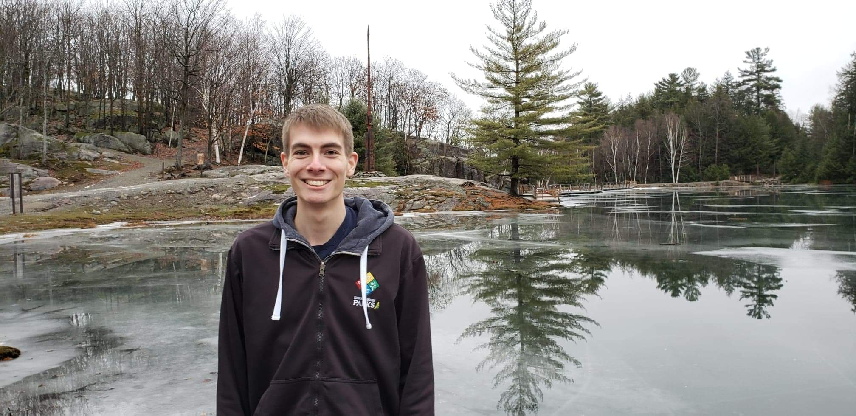
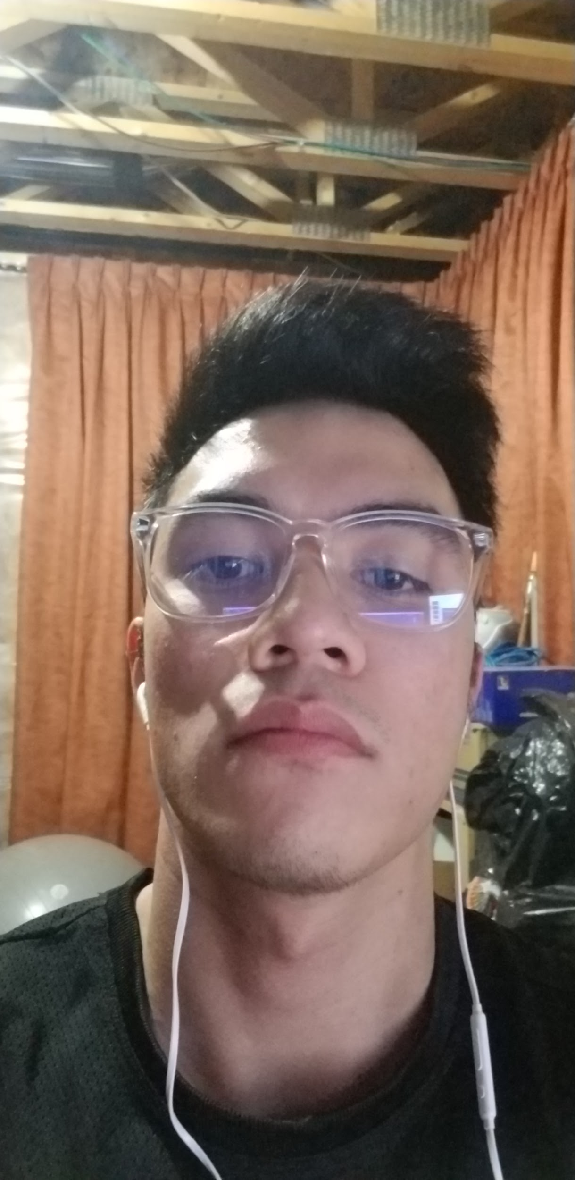
Team Introduction
Rational Luck Elephants
Avery Cameron
Renz Rivero
Yash Patel
Notes:
Avery
Renz
Yash

Slide 3
Problem & Requirements
Problem Definition:
Kids no longer know how to use touch tone phones
A new solution is needed to allow for effective impactful fire safety education
Notes:
Renz
Our problem definition is:
Fire and Protective Services’ children education program uses touch tone phones that kids no longer know how to use, this hinders 911 call demonstrations. Information to parents is going home in letter format which is not as effective as desired.
Rationale:
We created this problem definition based off of information from Candace’s initial presentation as well as through our first deliverable. The general presentation introduced us to the idea and the overall problem. Our notes when we came together identified that the main problem/need is a new phone system.
We then used empathy maps and an affinity diagram to understand the problem better and identify what we understood to be the focus and the needs of each group involved.
Finally, the first deliverable allowed us to ask more specific questions and improve our understanding and generate an improved problem definition.

Slide 4
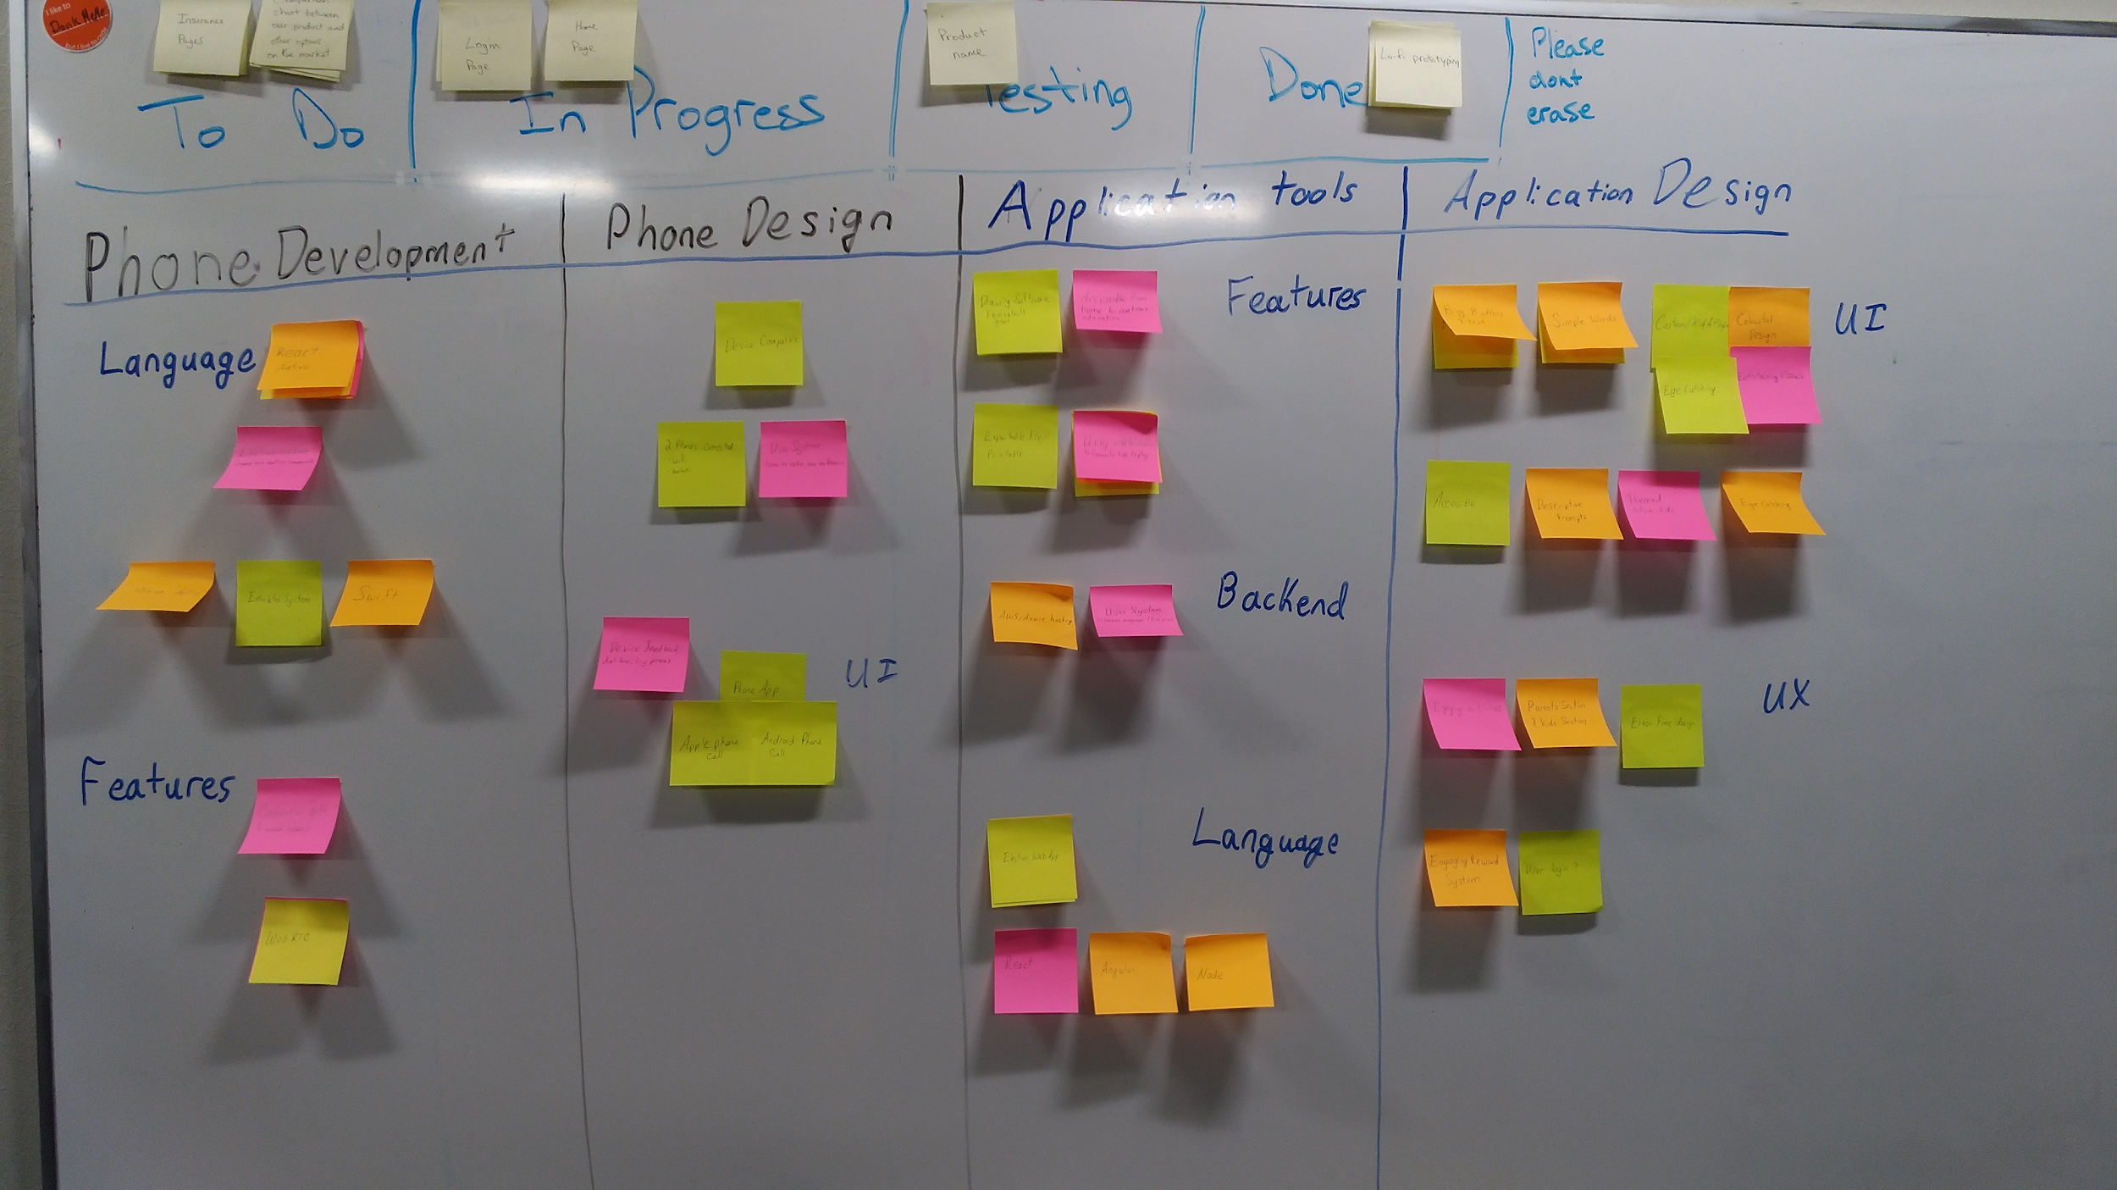
Problem Rationale
Affinity Diagram:
Notes:
Avery
Our Affinity Diagram, shown on the slide provides some insight into our initial ideas.
The Application Design tab generated ideas for how to make the app usable for children and familiar to the regular to phone app they are used to. As well, accessibility was identified in development as both Apple and Android phones had to be supported.
The Phone Development and design page identified problems to consider when designing an app accessible on all devices and additional design features for children.

Slide 5
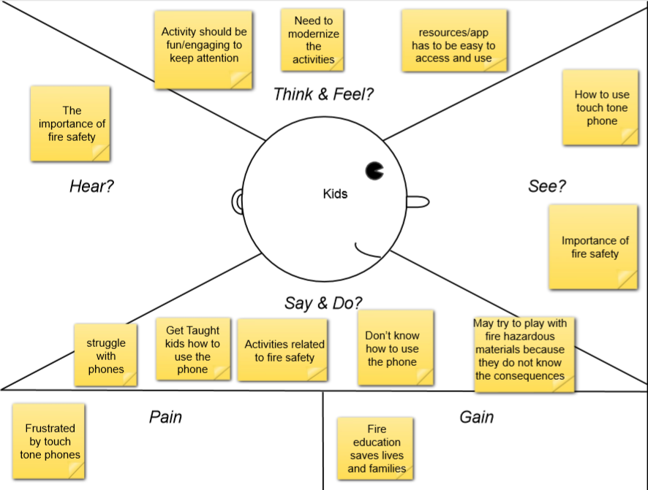
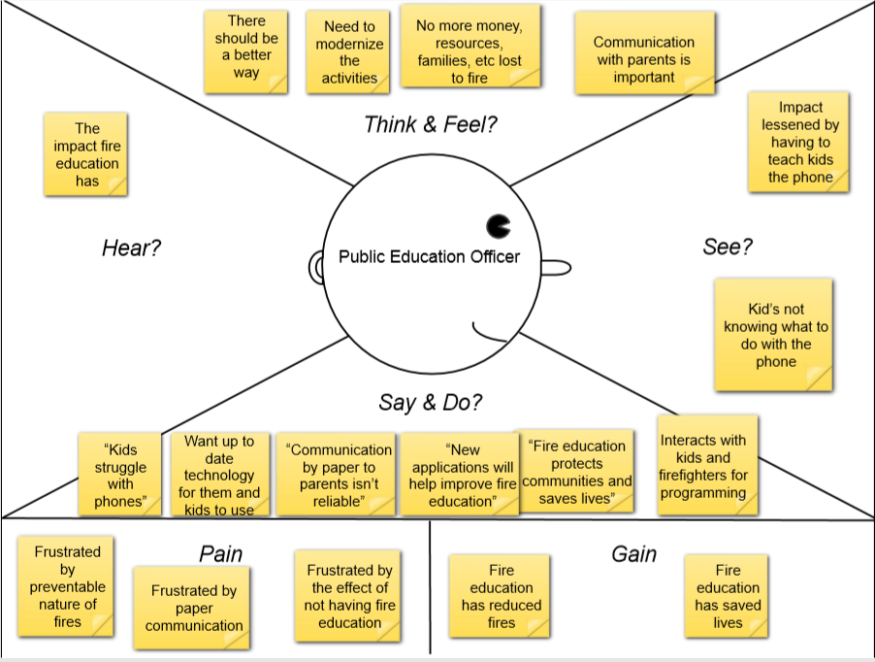
Problem Rationale
Empathy Maps:
Notes:
Yash
Our Empathy Maps allowed more insight into the problem as well as the users affected by the problem. Fire Safety & protective Services wanted to modernize the activity and thought there should be a better way. This empathy map allowed us to understand the need for a solution and the impact that fire education has as well as the struggle with kids using the phone. The Kids empathy map allowed us to consider what is most beneficial to them and what they are most familiar with.

Slide 6
Framing
Project Vision:
Create a solution to allow kids to practice calling 911 to add to the education experience in a way that is familiar to them.
Notes:
Yash
Project Vision:
Our Project Vision is a solution that lets kids practice the 911 call in a easy to learn way. To create an enjoyable and educational experience and enhance the education and make firefighter’s 911 teaching more effective.
This vision is from the combined information from the empathy maps, affinity diagram, and information from Candace and the feedback she provided.

Slide 7
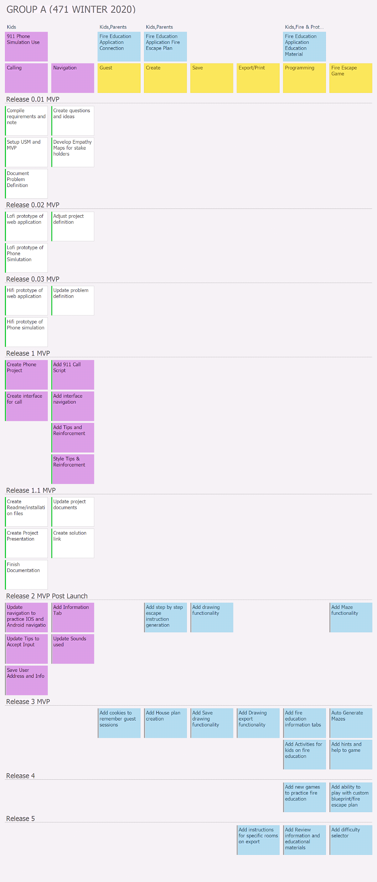
Framing
User Story Maps
Notes:
Avery
Shown above is our Final version of our User Story Map, Our initial versions contained ideas of a web application and a user system but these were paired down over the deliverables discussions and reviews. As we got down to what is really required, our User Story map and ideas changed as well to focus on a simple phone app to take the place of the touch tone phone that was used before.
We started with our requirements gathering and initial problem definition and continued on to lo-fi and then hi-fo design.
Our Release 1 MVP is what we have design and created and will demonstrate today. Simple phone interface with tips and reinforcement and a script to help with the 911 call.
We also generated ideas for future development as seen in Release 2 Post Launch

Slide 8
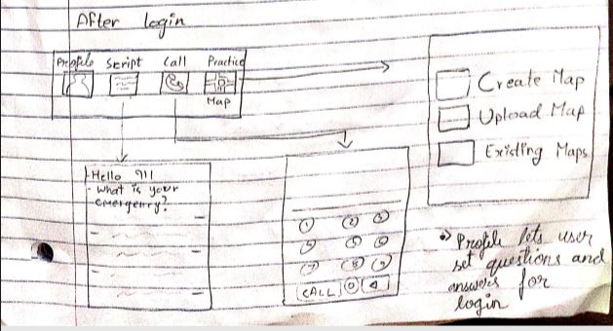
Lo-Fi Prototypes & Insights
Ideas:
Broad
Activity Focused
User System
Game like
Feedback:
Phone Call is the main goal
Positive Reinforcement is important
Too many features, consider timeline
Need Calling, Address and Questions
Notes:
Renz
Ideas:
Our Lo-Fi Prototypes contained many different ideas.
A lot of these main ideas presented were broad in both scope and unique ideas. Ideas we had during our lo-fi design phase were a user system, a web application, navigation to the phone app from within our main app and achievements to gamify the app.
Feedback:
The main feedback received was that the phone call is the main goal of the app, other features are secondary. There was also conversation about the amount of features and needing to remove some features for later releases. We removed our web application idea and focused on calling and questions involved in a 911 call.
Design Idea Relations:
Our prototypes used different design ideas but were all made with people centered design in mind. Key features were learnability, memorability, efficiency, utility and a positive experience. Discoverability with affordances, signifiers and mappings were included as well. The designs were simple to focus on, emulates real life and is usable and learnable which help create a memorable interaction.

Slide 9
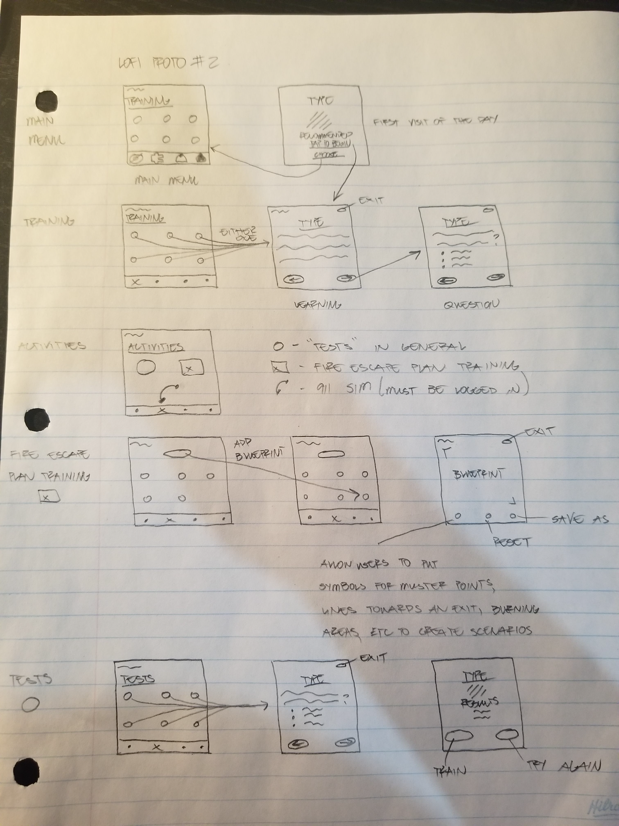
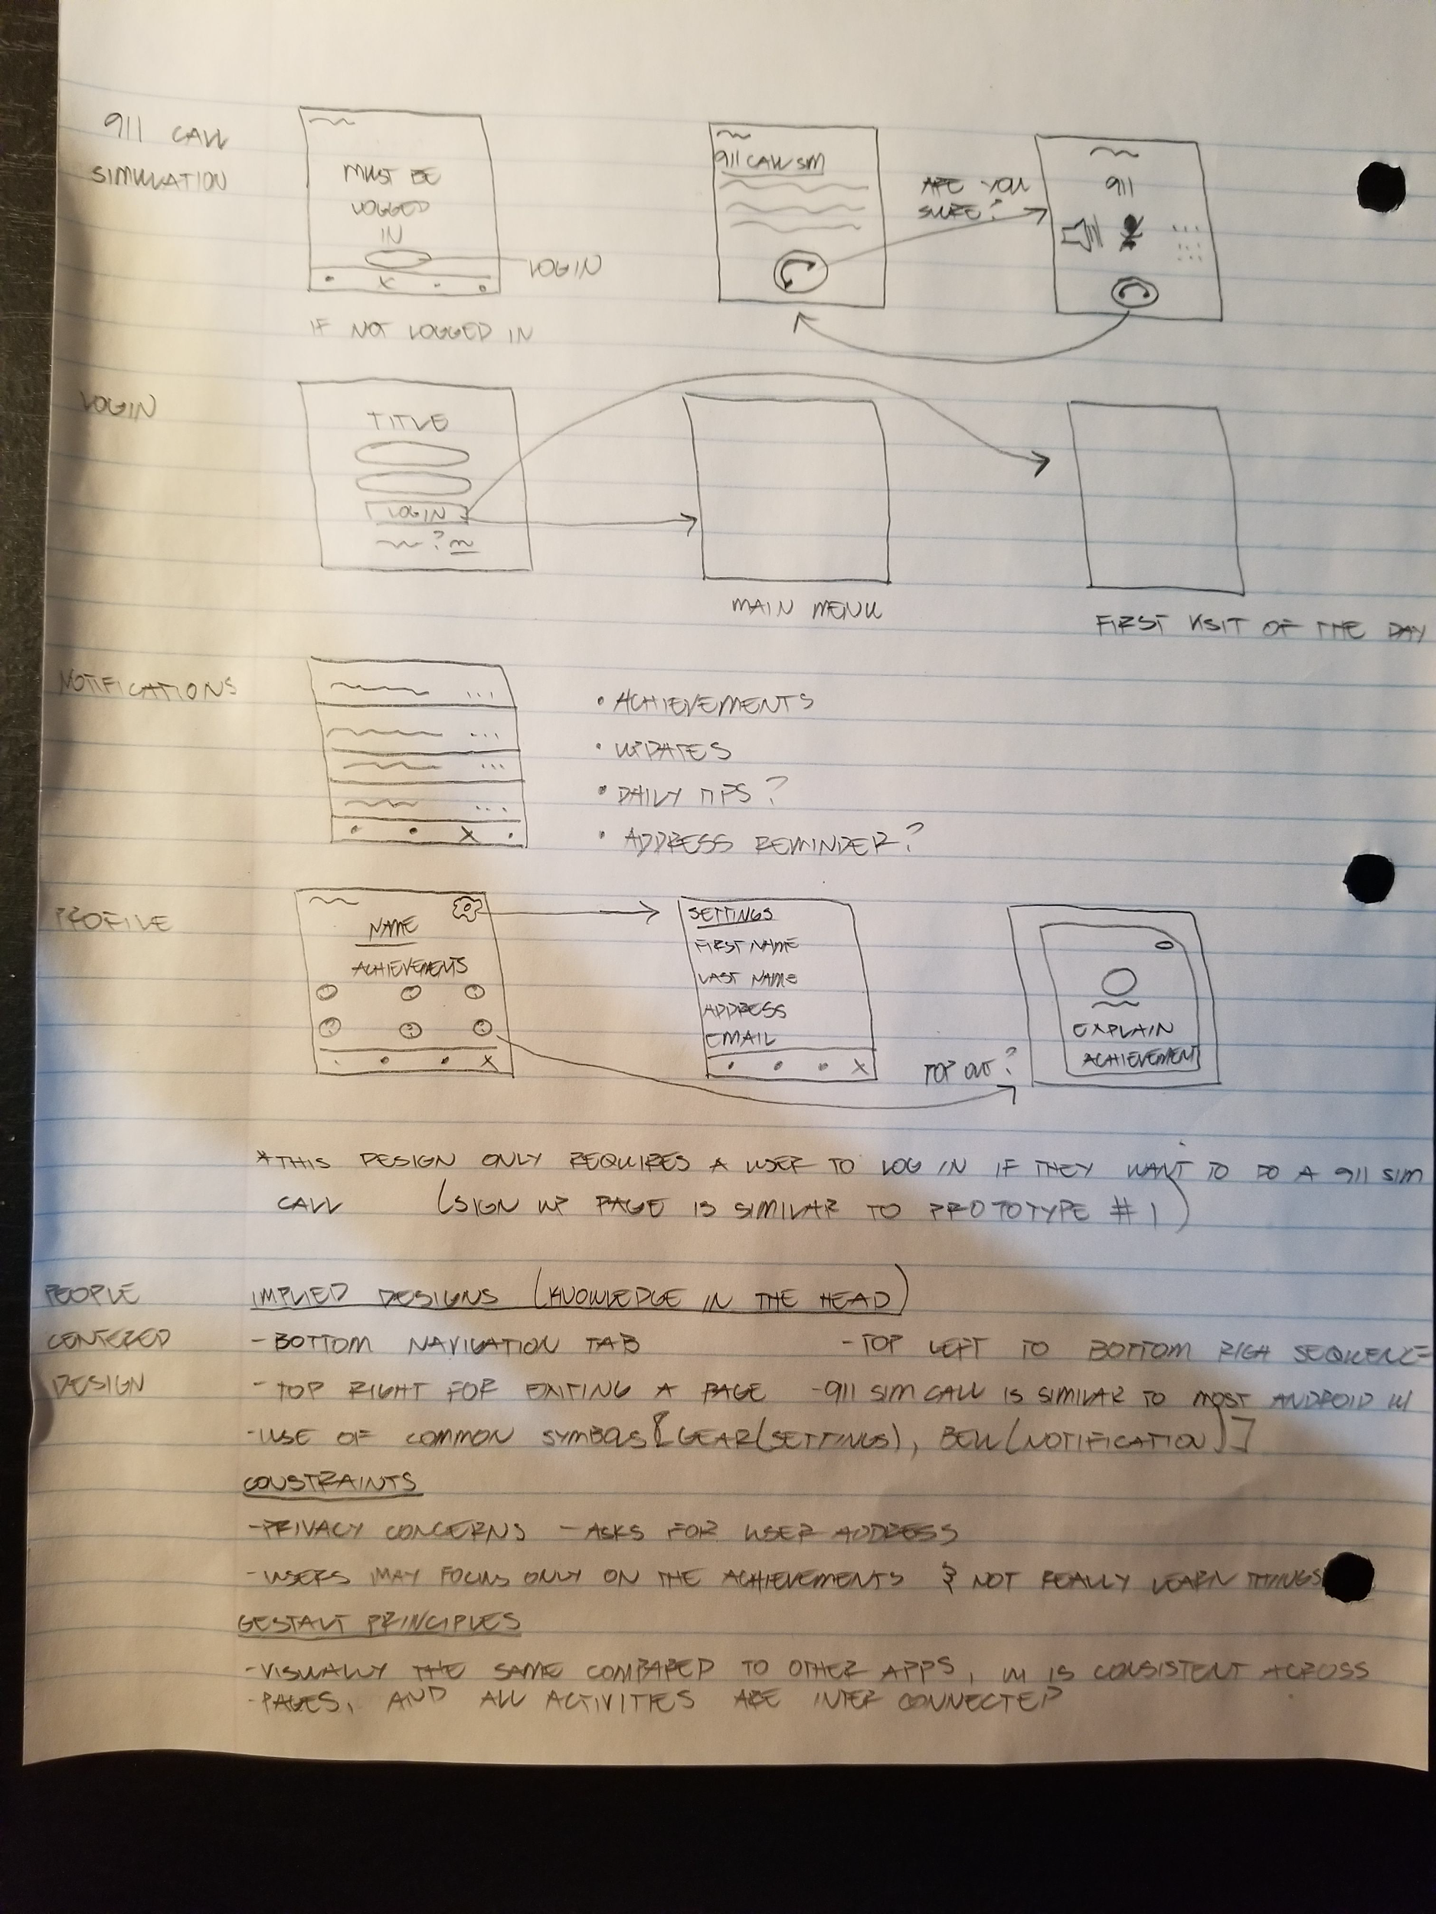
Notes:
Tons of features
Activities page - 911 calls, fire escape plans, etc
Knowledge testing (exams)
Login/Signup feature
Notification tab
Profile page for achievements (Engagement)
Highly ambitious designs given the time we had for the project

Slide 10
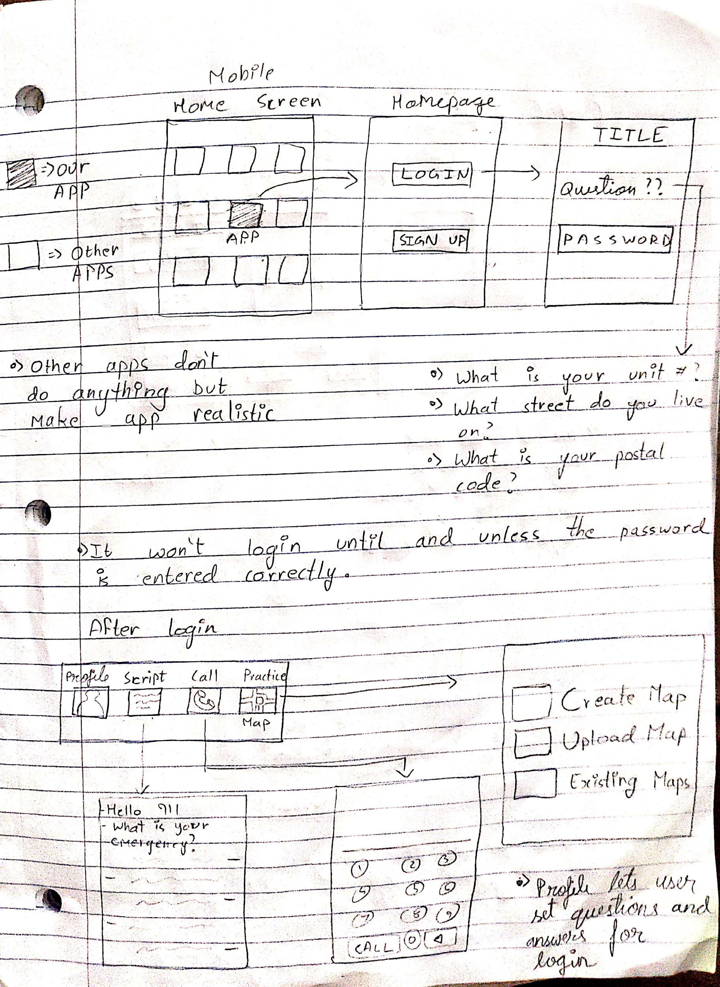
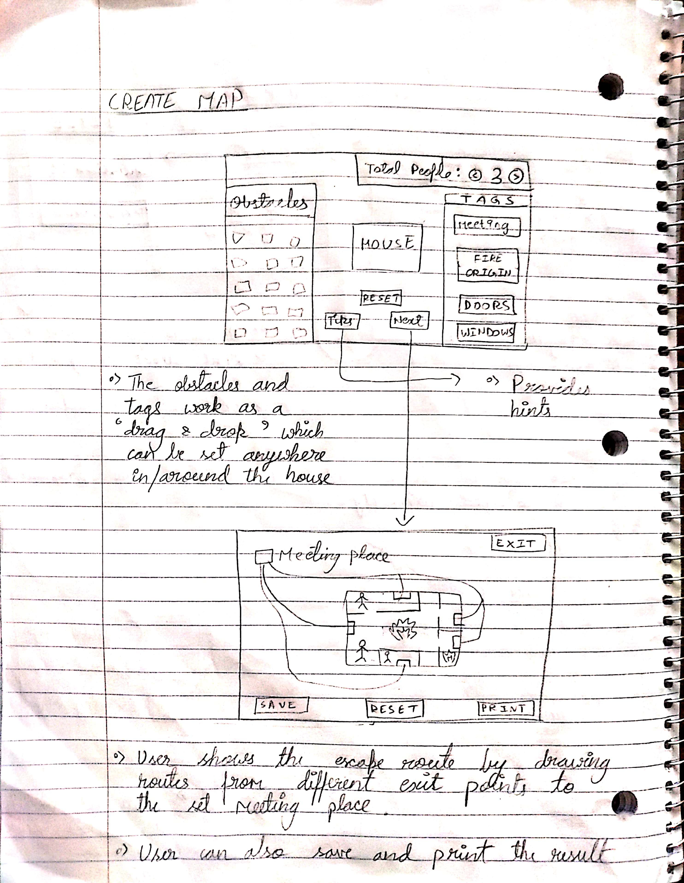
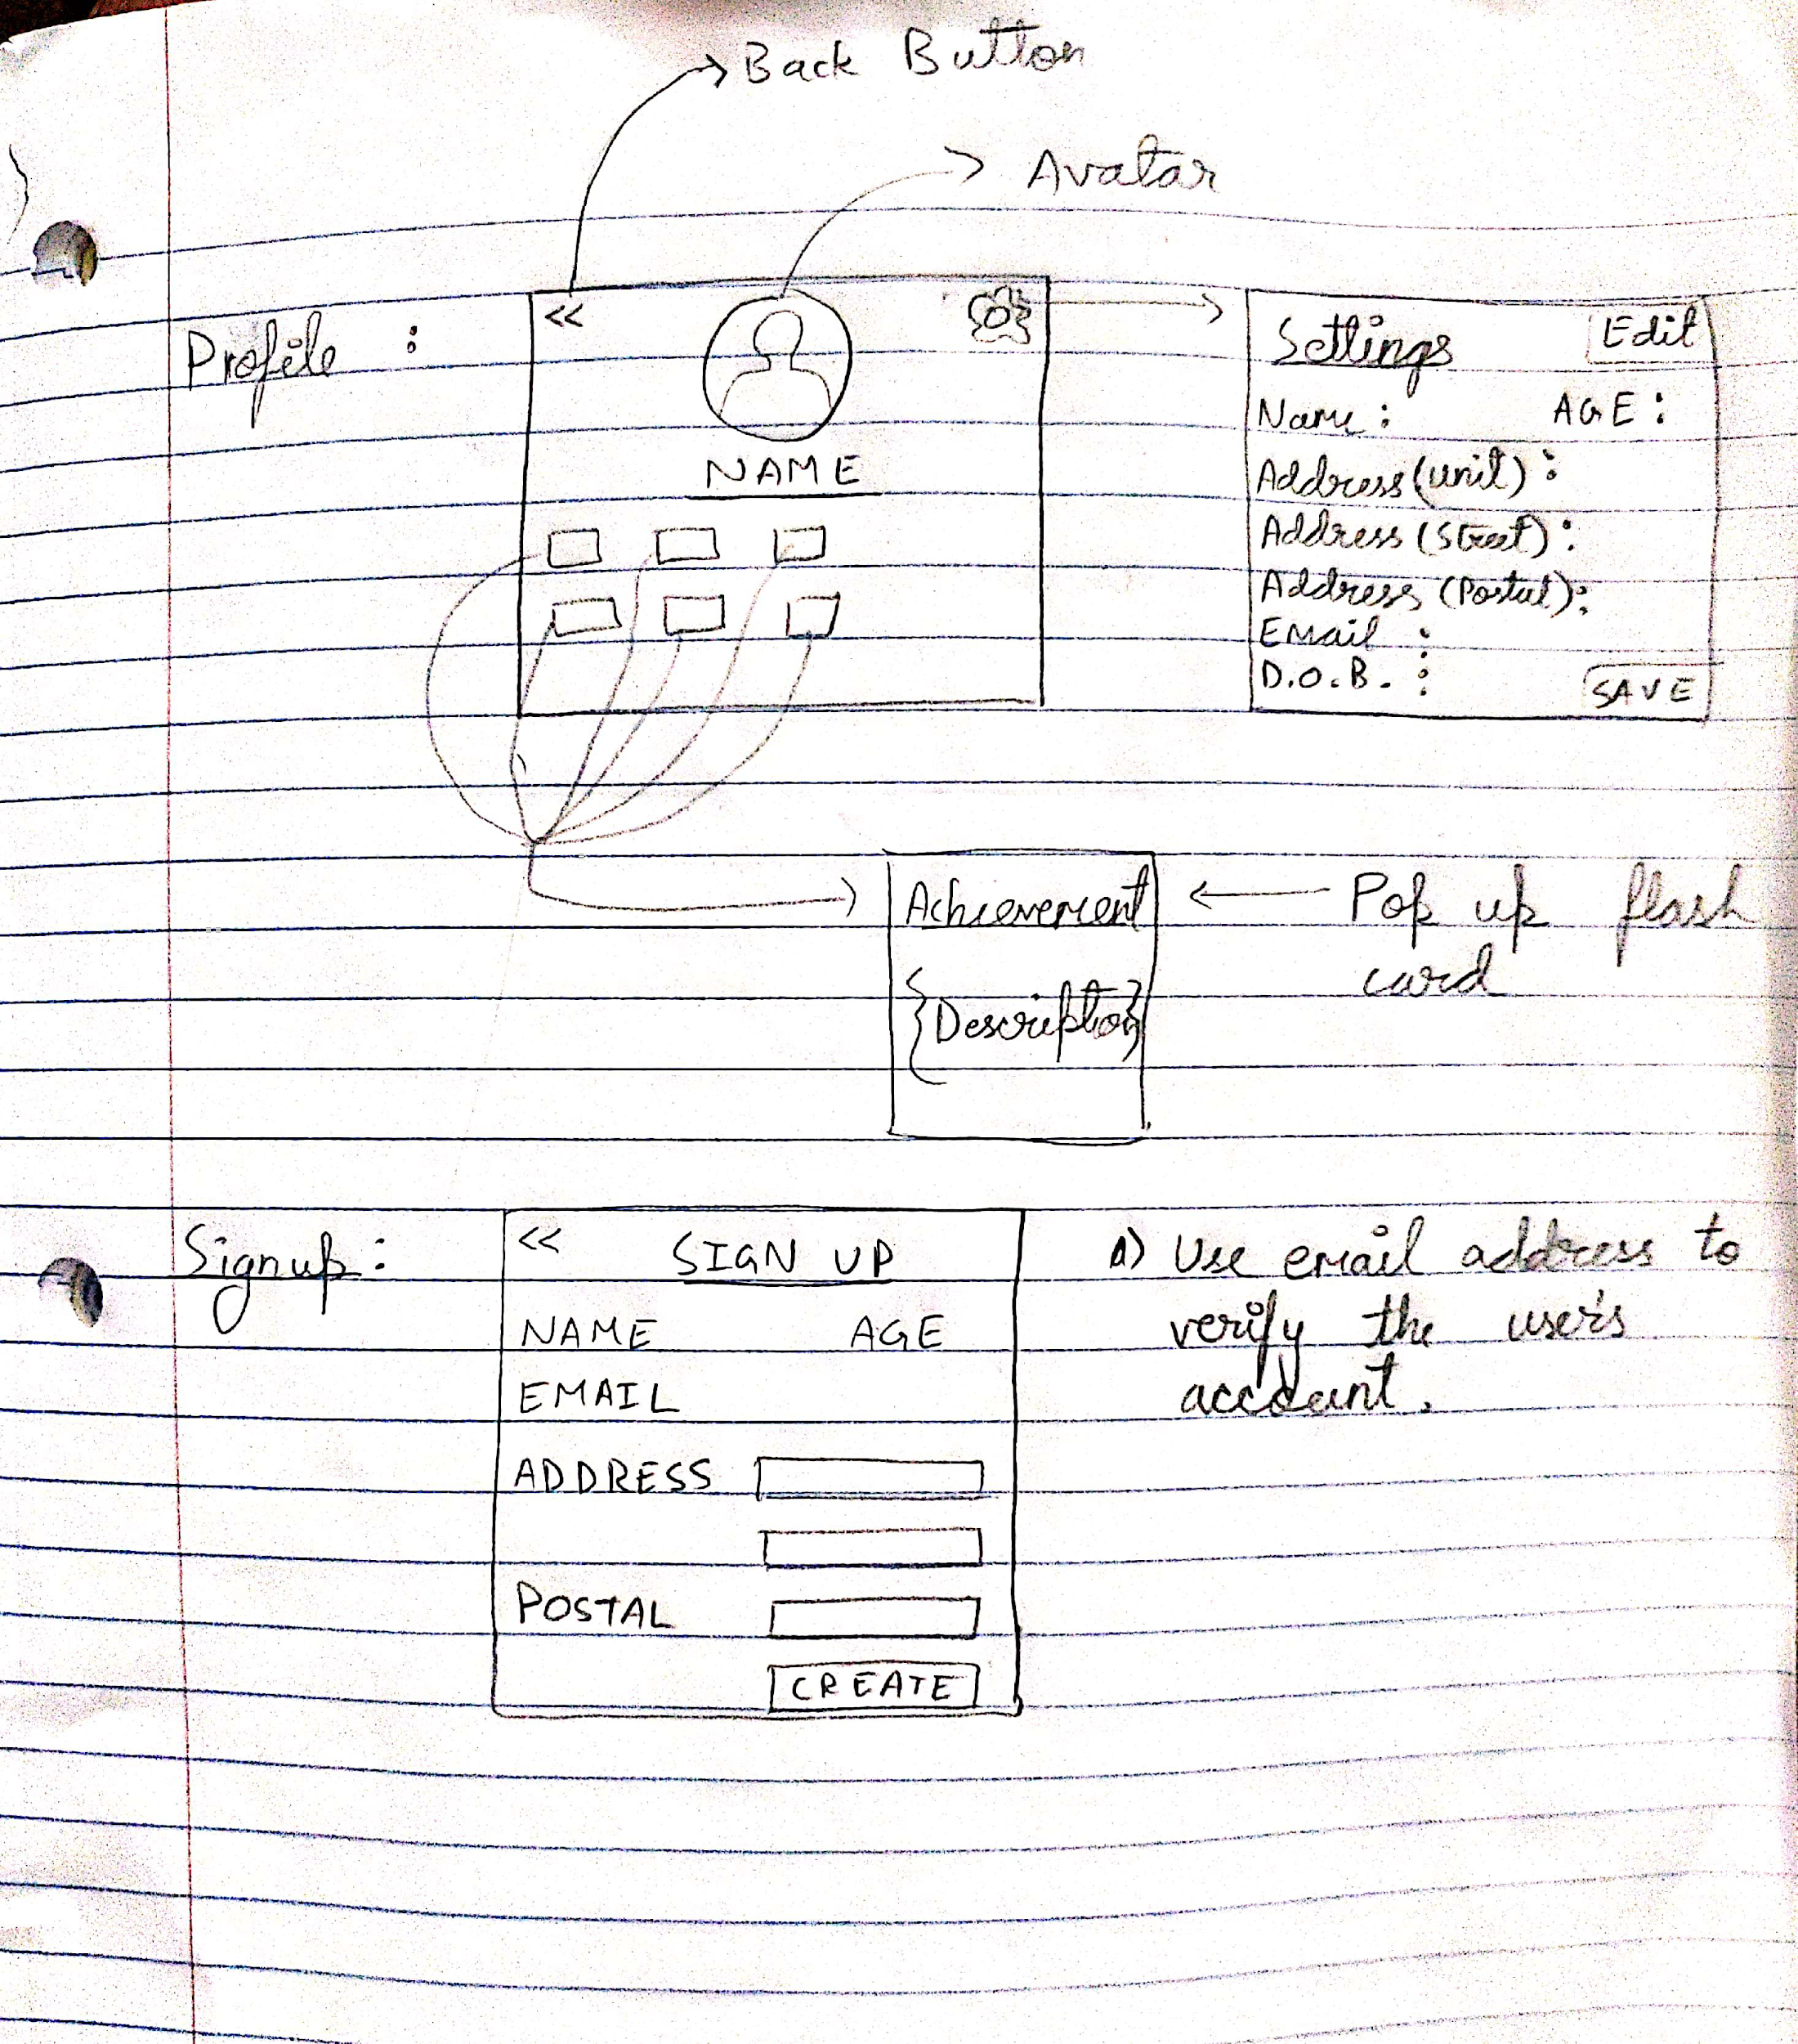
Notes:
More highly ambitious prototypes

Slide 11
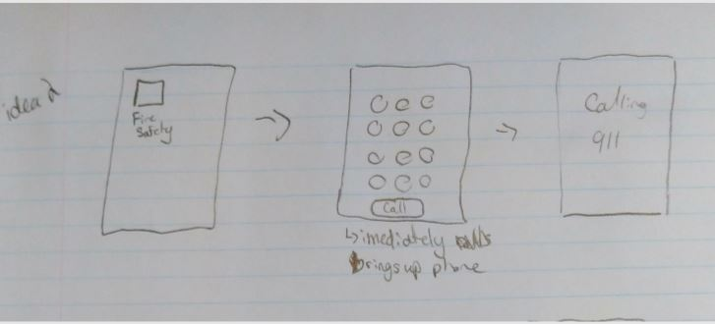
Notes:
This more simple prototype is one that inspired our future design, the phone call being the main goal and the consideration of time made this prototype more useful. The above design was merged with some other prototypes with a script page as is seen in of Hi-Fi prototype.

Slide 12
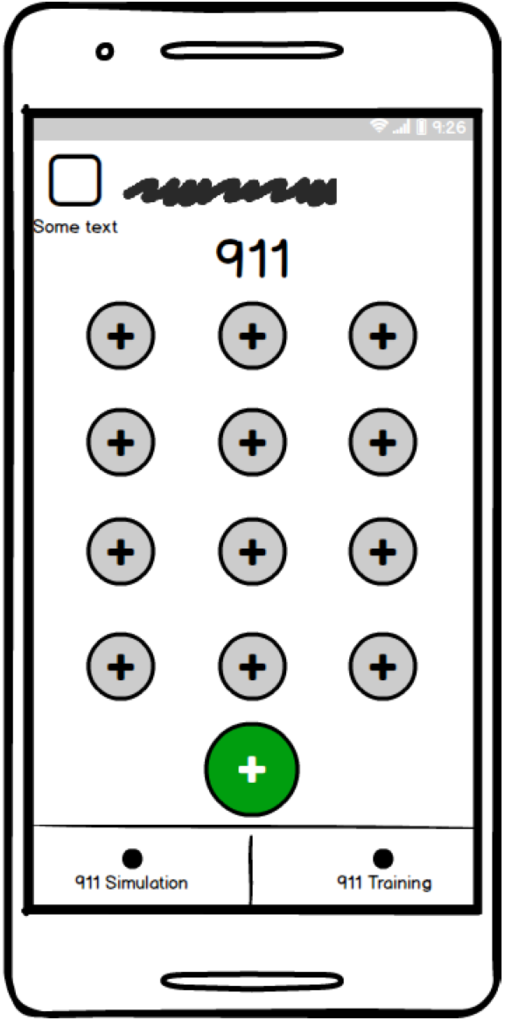
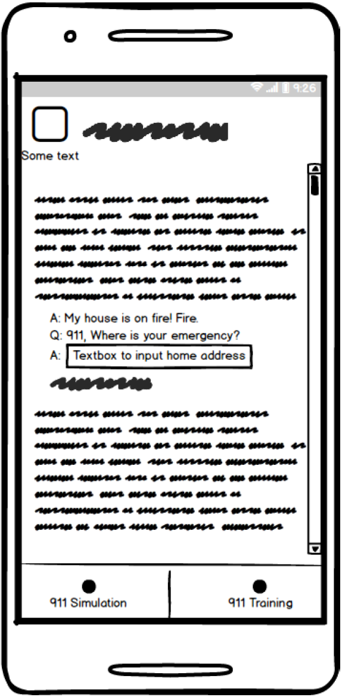
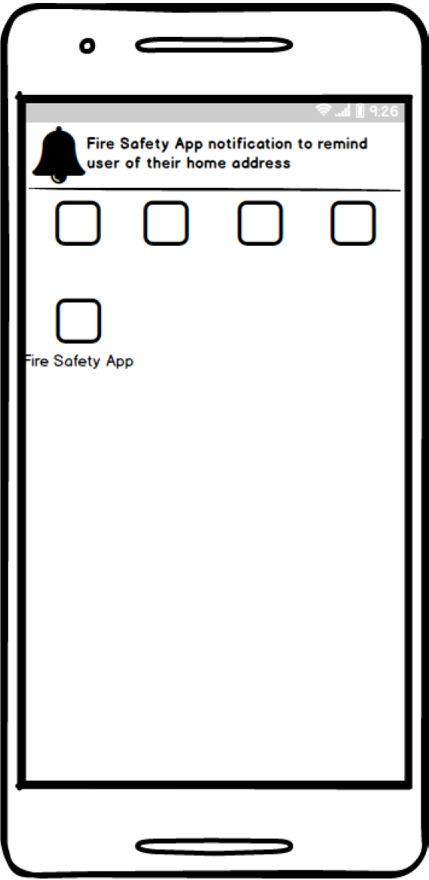
Hi-Fi Prototype & Insights
Idea:
Simple/realistic Interface
Educational Reinforcement Focused
Feedback:
Use Sparky (International symbol)
Use Sounds (keypad tones)
Assume supervision
No outside notification
Only a Call Simulation
Main Screen
Script Screen
Notification
Notes:
Yash:
Ideas:
Learning from our Lo-Fi Prototypes, our Hi-Fi prototype kept it minimal and functional — taking into account what the key customers mostly needed and the timeframe we had to work on the project.
There are only two screens/scenes that the user can navigate to.
The main screen is based off of what the customer/user would actually see in real life when making a call. The second screen is essentially a page of 911 scripts where the user (children) can train/learn what to say during a 911 call.
Feedback:
Reviewing the prototype, important feedback was received to better reinforce learning through the use of Sparky (the international symbol for Fire Education) this helps to keep messaging consistent. As well, touch tones when dialing a number can better engage children when using the app.
To keep the project more simple and functional, it was discussed that there is no need to have outside notifications from the app as this could be annoying. And to assume that the children using the app is supervised by a fire educator or a guardian.
Lastly, one of the most time saving solution that occured from our check-in was that the call was just a simulation. It didn’t need to be a real call.
Design LInks:
The hi-fi prototype expands on our lo-fi prototypes’ goal of learnability, usability and desirability. As well, the bottom nav bar uses the enclosing principle to present the connected functionality. As well, the titles and intended icons help with signifiers and affordance. As well, the illusion of the call embraces the “Wizard of Oz” experiment as the call is mediated by another person to create the illusion of a real call. The app is Low Threshold, Low ceiling with simple navigation and functionality.

Slide 13
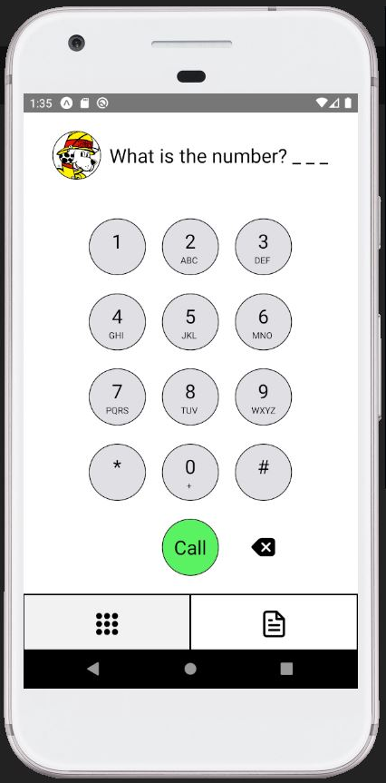
Solution
React Native
TypeScript
Built with generic and custom components
Can use native code
Test and run on your phone or an Emulator
Notes:
Avery
Our App is built using React Native and written in TypeScript. React Native lets you build mobile apps using only JavaScript/TypeScript using React. It doesn’t build a mobile web app but a real mobile app that is the same as something built regularly for iOS or Android. We used TypeScript due to it allowing typing of variables unlike JavaScript which helps it to be more maintainable when transfering development.
React Native allows you to test in the browser, in an emulator or iOS Simulator and directly on your phone. As we did not have a mac to test the app on an iOS simulator, being able to run it live on an iOS phone was extremely useful.

Slide 14
Solution Demo
Notes:
Avery
Now we will do our Solution Demo.
Here is our app running on an android emulator, we also have gotten our app up and running on real android and apple phones as well.
This is the main call screen that the child would be presented with when they open up the app. The main call screen is similar to the lofi prototype that we showed that inspired our hifi design and is our hifi design with the tip box at the top and the nav bar at the bottom completed. The phone call screen is the completion of the ‘Interface for a call’ task from our USM/MVP. The bottom nav bar uses enclosing to show the connected buttons for navigation and the icons signify this call screen as well as the script screen and afford clicking. The slight highlight is also a signifier for which screen is currently selected and helps show the state of the system to the user.
The call screen allows the user to type in any number but after 3 numbers are pressed, the fourth number alerts them that it is too long. This constrains the child to just 3 numbers.
Each number provides dial tone frequencies that you would hear when using making a call on your cell phone.
When 911 is entered and the call button is pressed, the call is completed and the child is walked through the phone call. This is where a firefighter or parent would help the child with reading and answering. The next and previous button again afford clicking and the arrow icons signify the direction as well. These tips and reinforcement messages maintain consistency with the feedback sound and the images used. The app maintains its low threshold low ceiling that was shown in the hi fi design.
On the script screen we have the various questions that may be asked. In addition to this we also have similarity and symmetry with the display of other emergencies as headings and additional questions as extra prompts.
T
Do a high-level overview of your solution, including screenshots of key experiences
Demo your solution
Discuss links to lo/hi-fidelity prototypes
Discuss experiences as they relate to your team’s USM/MVP
Again, ensure you link your design ideas back to a minimum of three topics discussed in class relating to people centered design (affordances, gestalt, constraints, etc.)

Slide 15
Future Work
Updated Sounds
Save User Info
Add Information Tab
Notes:
Renz
For future work, we came up with different ideas that we couldn’t complete within the time we had or that need some discussion before they are done such as saving user info or updating the sounds we use for feedback. General updates could be made, such as the update of sounds and navigation to improve the overall experience based on feedback in user testing. As well, we want to allow user info to be saved such as the address, their phone number and other helpful tips that could be used to enhance the training simulation.

Slide 16
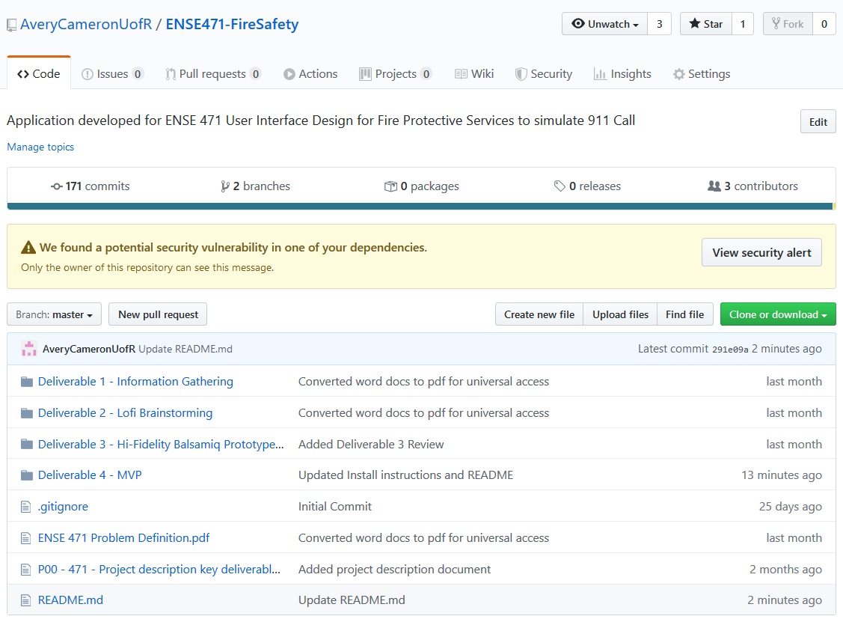
GitHub “Stamp Of Approval”
Notes:
Yash
Our GitHub is all up to date, all files, readme info and functionality is finished. Our deliverables are separated out into folders and we created a readme and installation file for our app as well as additional resources to help with using it. Folder structure was updated as well.

Slide 17
Group Reflection
•How did you feel about this project? What did you like about it? What did you dislike?
The project was a relevant experience. We liked how it wasn’t just a class that focused on the books and had some real-life experiences
•What did we learn about ourselves as we collaborated and worked through this project?
The most important thing reinforced in this project was the importance of communication. It wouldn’t have been possible if we didn’t communicate.
•How will you use what you have learned on this project going forward?
We noticed already jobs looking for experience in Balsamiq and React Native and JavaScript. As well, the setup of our user story maps will also be valuable as we join development teams in the future.
Notes:
Avery #1
Renz #2
Yash #3

Slide 18
Thank You!
Notes:
Thank you for the great semester and project, it was a valuable experience and we hope you enjoyed.

